Slide 1
Homeless Management System
Team Pulse
Rachit Agarwal
Gaurav Lohani
Vidhi Patel

Slide 2
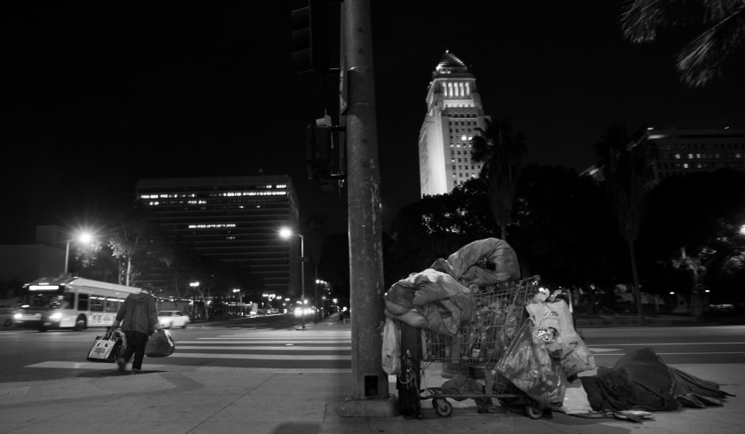
Problem Statement
The greater problem faced by the society today is the need to keep a track of the homeless. It is extremely crucial for them to be served, as they are also a part of the community. And keeping a track of the homeless is extremely difficult as their data can often be scattered.

Slide 3

Solution To The Problem
Manual data collection effort is limited and might result to flawed decision making. Thus, it is import ant to maintain a single record for each existing homeless, along with the initiatives taken to rescue them for maintaining their track record.

Slide 4
Our Approach
Track the homeless
Provide Essentials
Generate and Record Costs
Details of the homeless person recorded
Assign homeless with suitable needs
Calculate detailed cost of provisions for each homeless

Slide 5
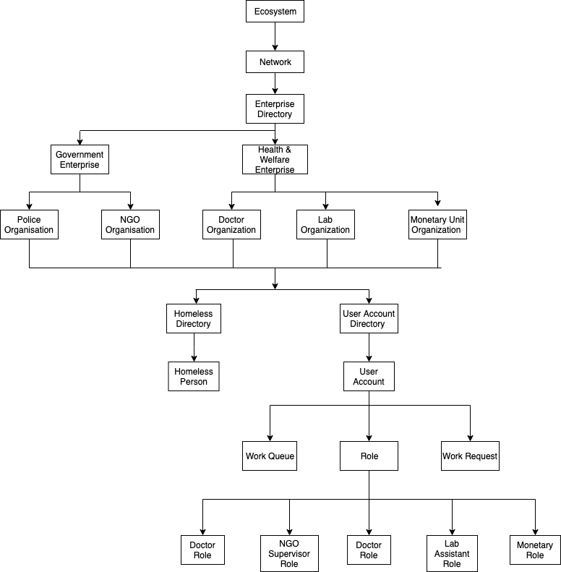
System Architecture

Slide 6
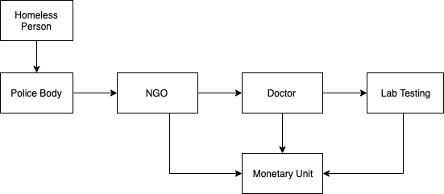
Work Flow

Slide 7
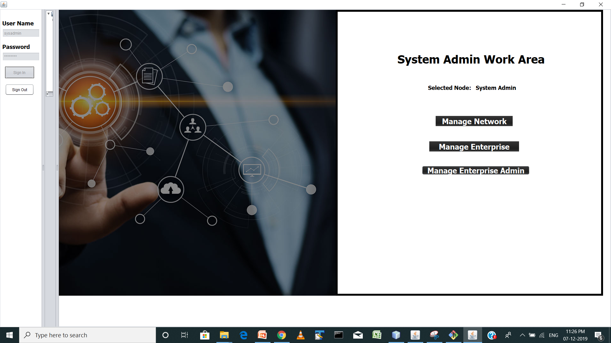
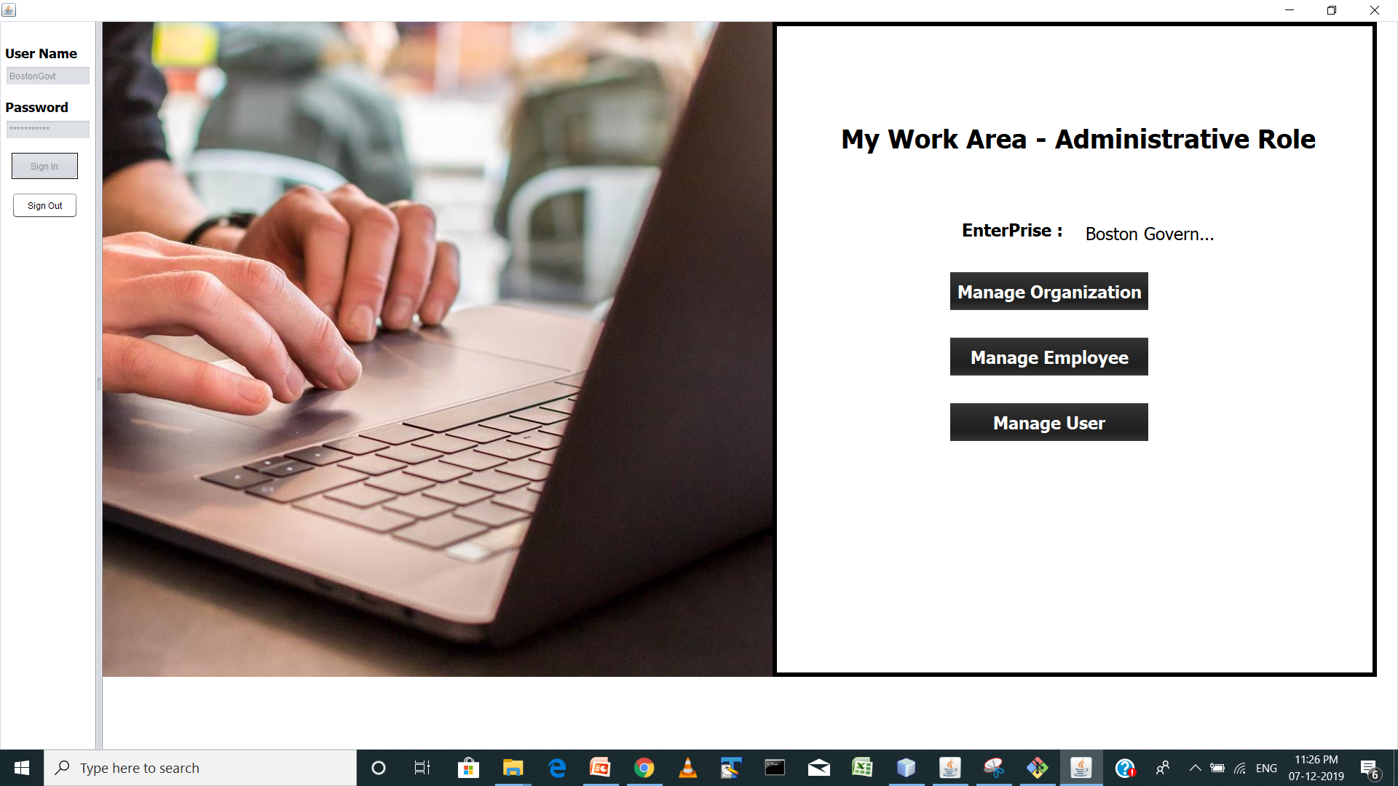
Login Use Case

Slide 8
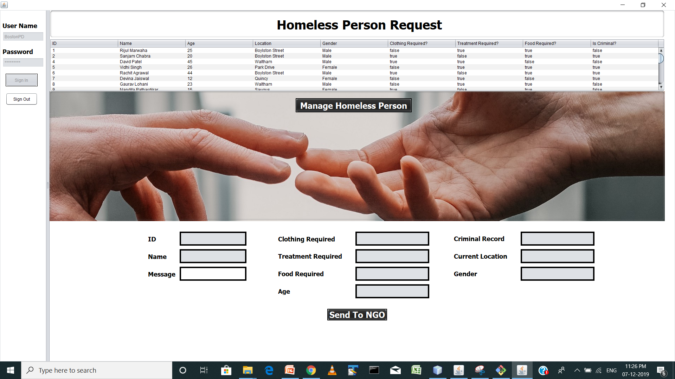
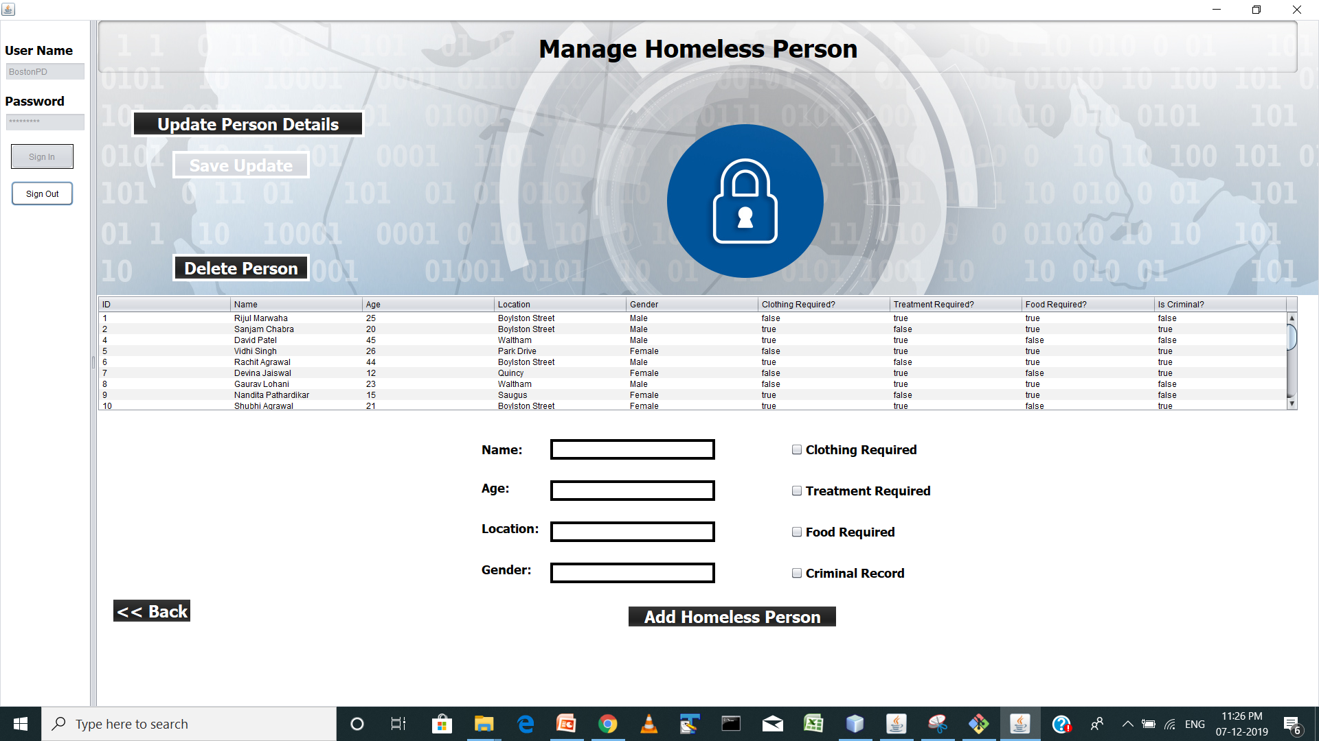
Police Use Case

Slide 9
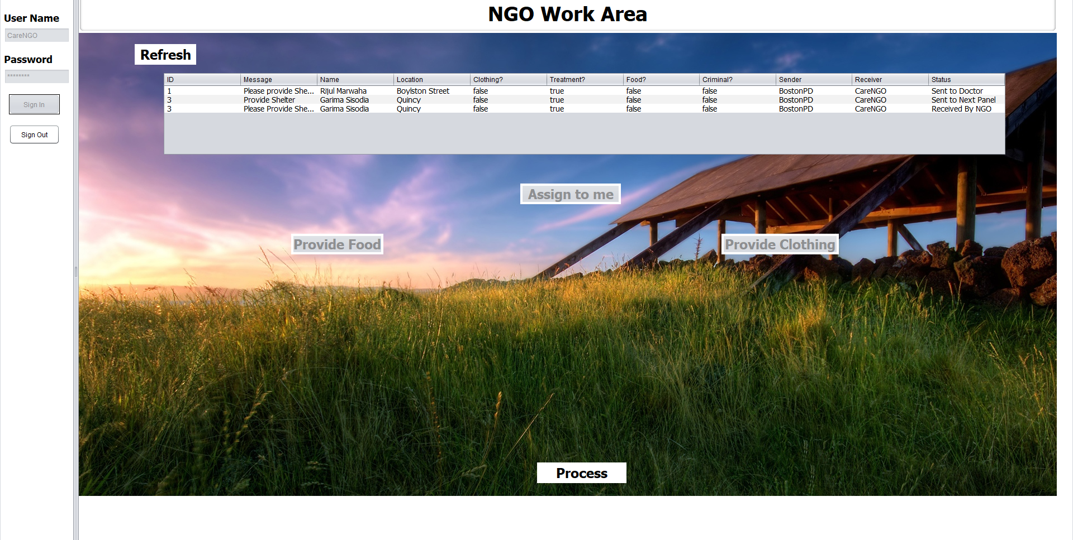
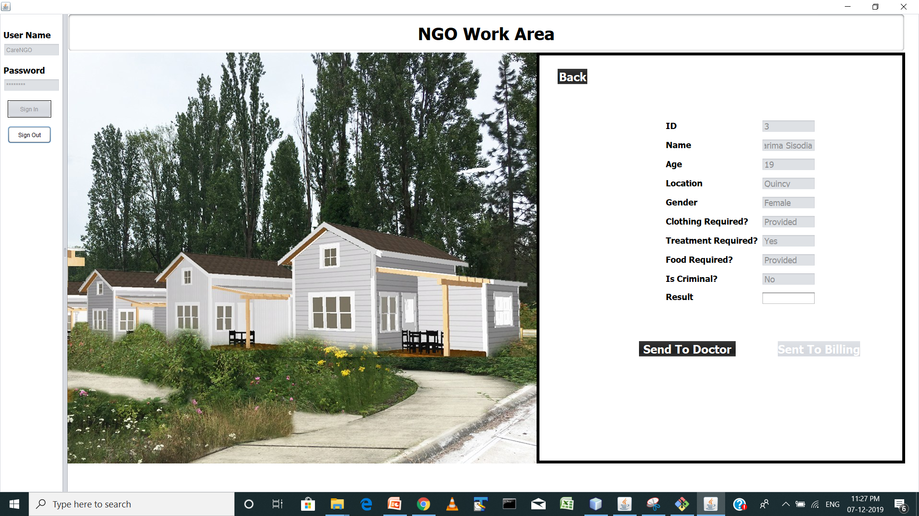
NGO Use Case

Slide 10
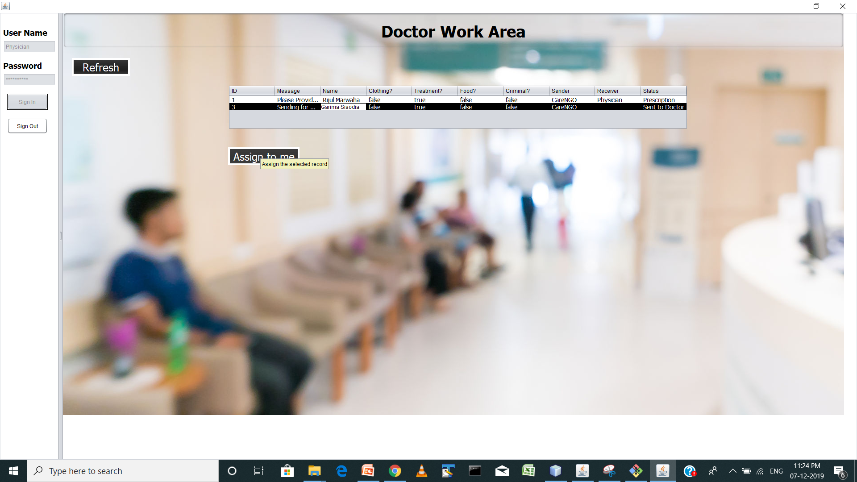
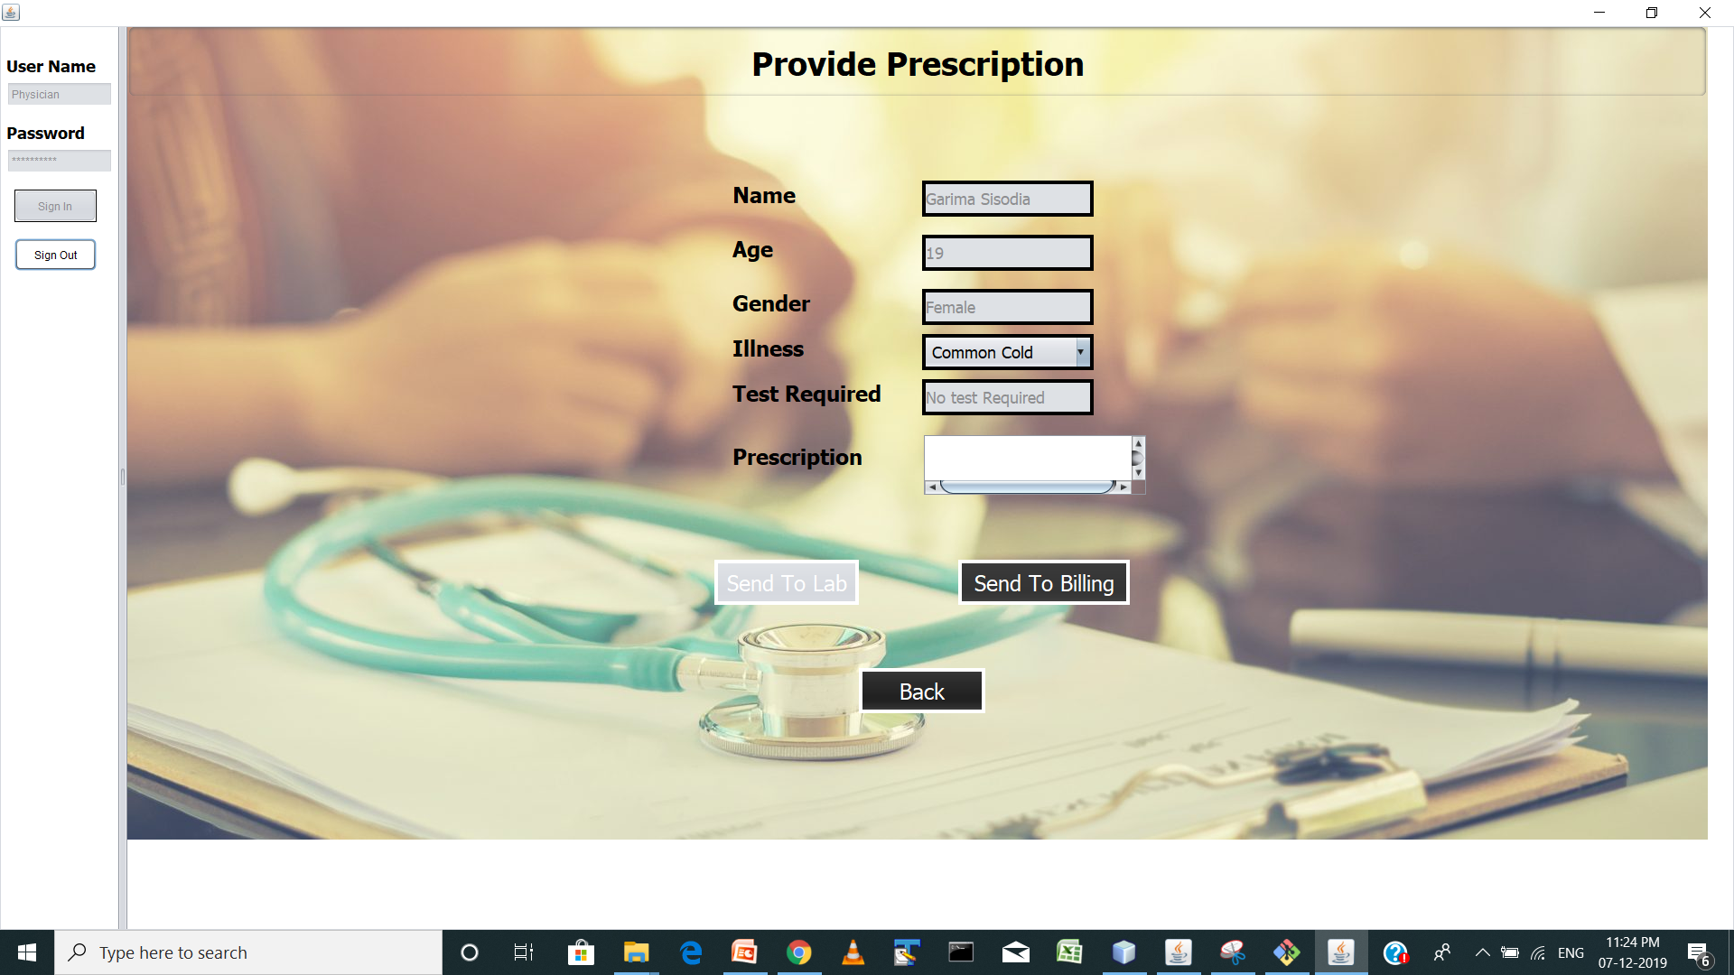
Doctor Use Case

Slide 11
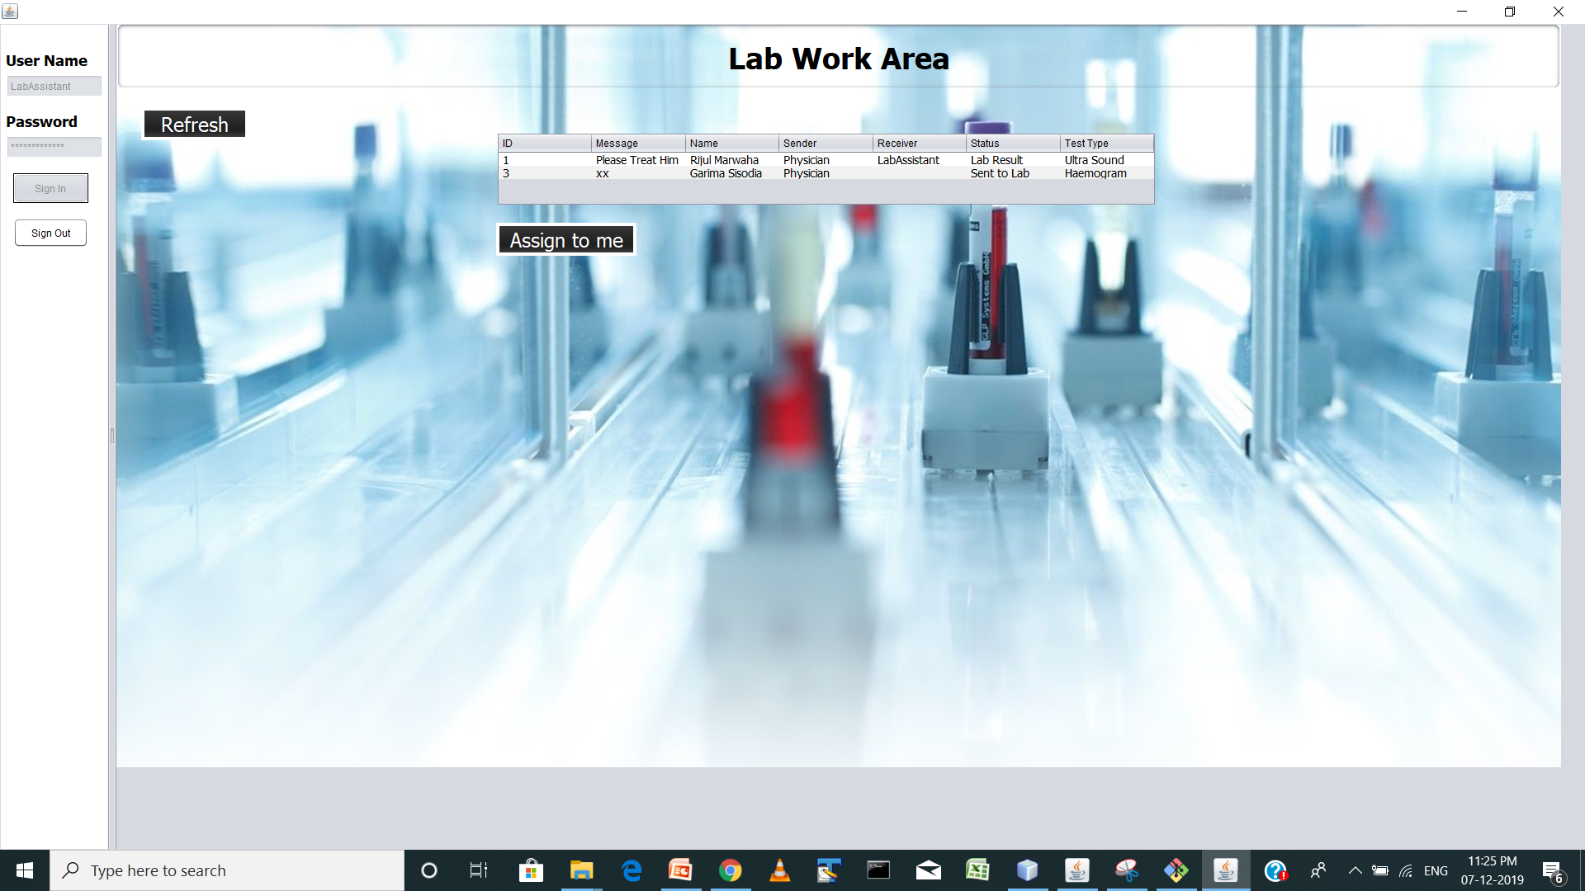
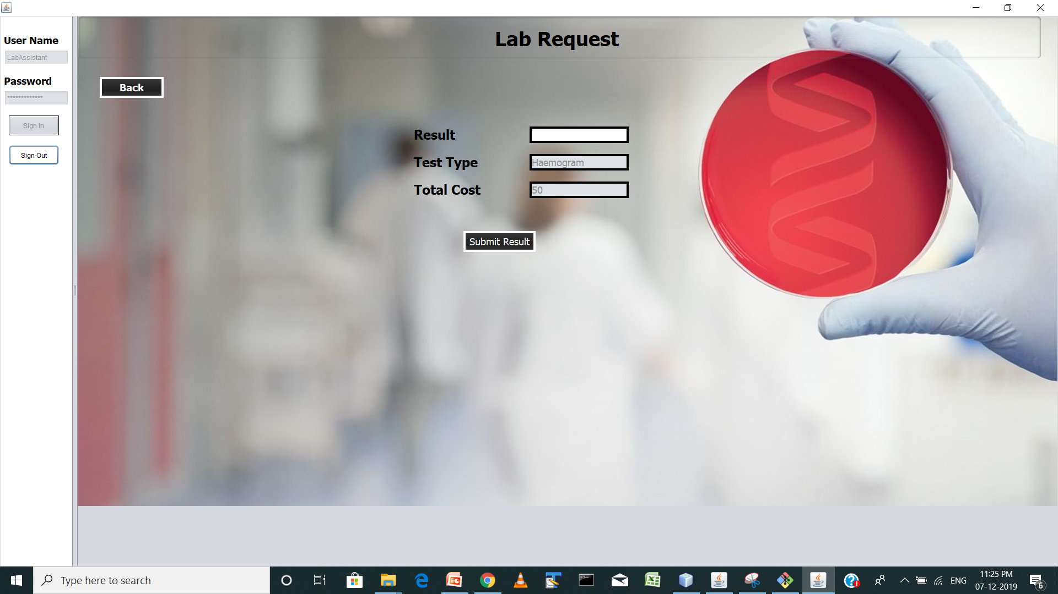
Lab Assistant Use Case

Slide 12
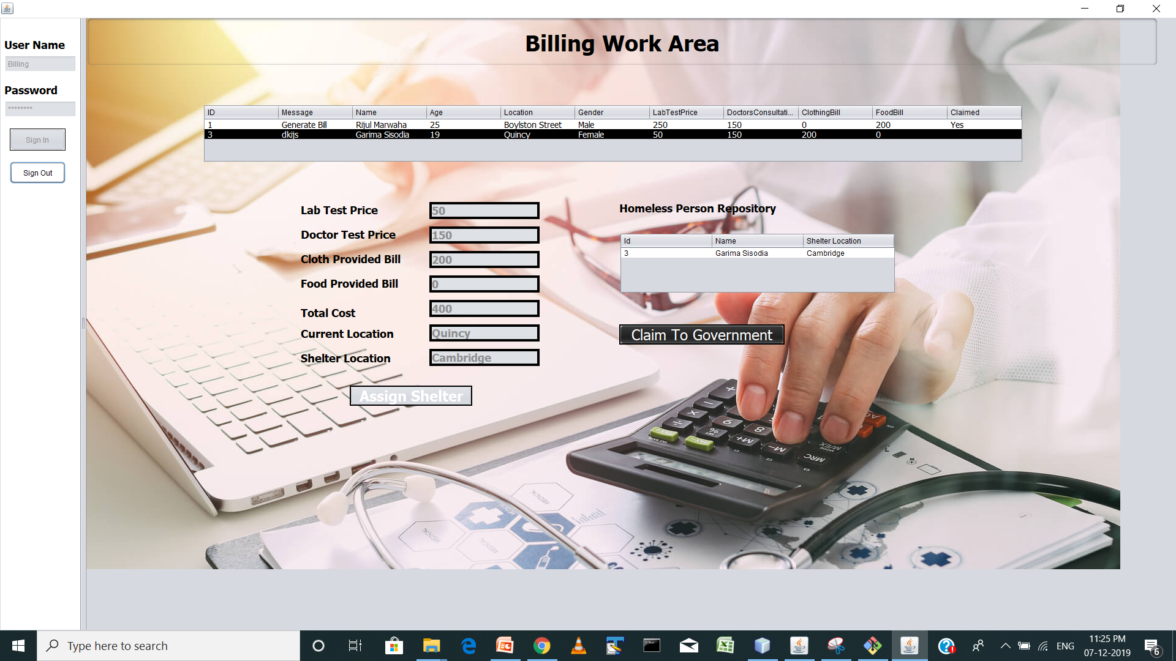
Monetary Unit Use Case

Slide 13
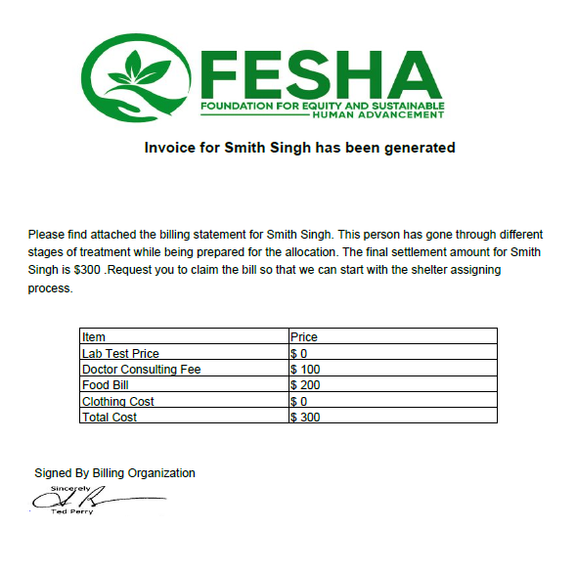
Invoice Generation

Slide 14
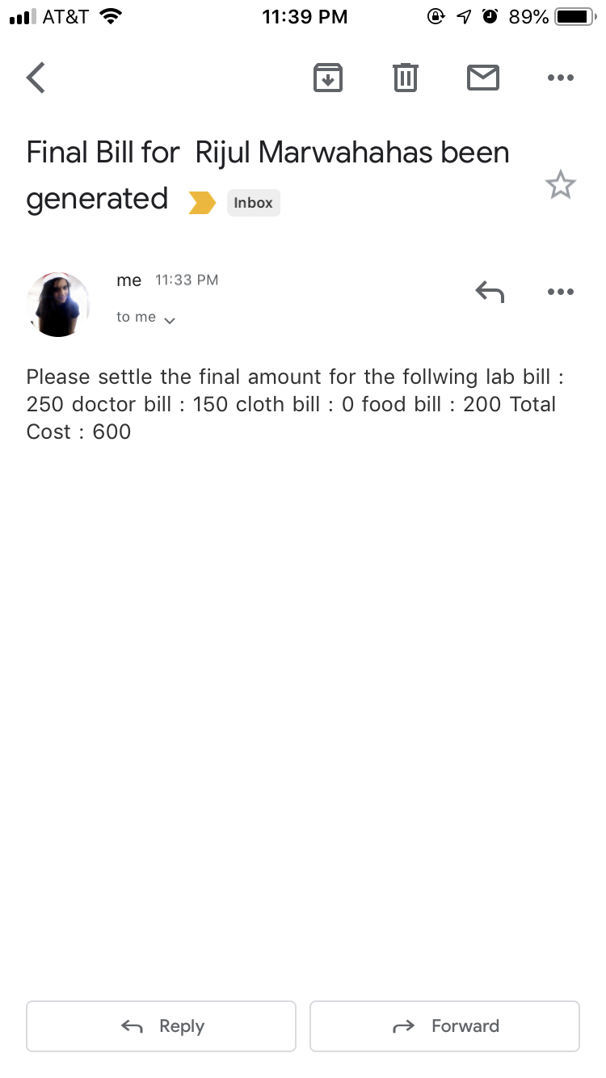
Email Notification

Slide 15

Future Scope
Google Maps can be used for identifying the nearest shelter location to the homeless person.
Reporting can be done based on the number of homeless people captured versus the census in order to calculate per capita homeless ratio.

Slide 16
Thank You!

